Slide 2
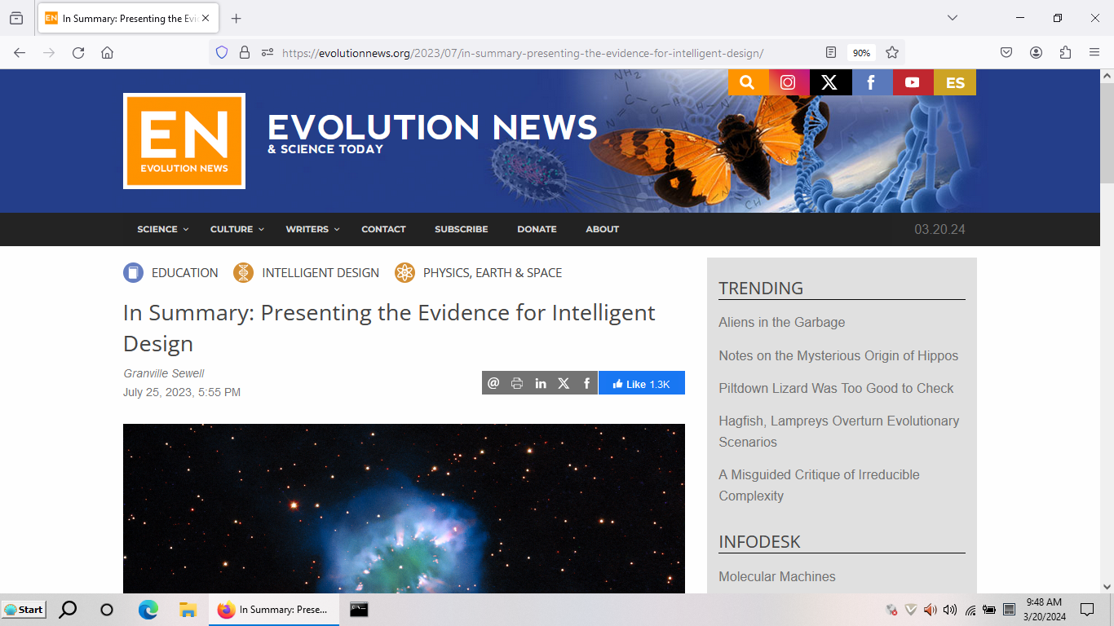

Slide 3
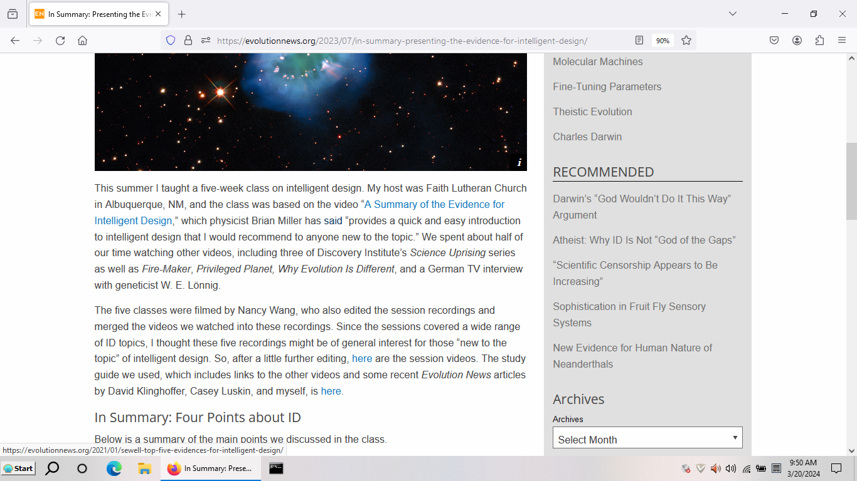

Slide 4
A Mathematician’s View of Evolution (English and Spanish subtitles)

Slide 5
The video “A Summary of the Evidence for Intelligent Design” begins with a short discussion of the “local fine-tuning” of conditions on Earth but then quickly moves to the more powerful evidence from the “global fine-tuning” of the laws and constants of physics and the initial conditions of our universe.
Video: A Summary of the Evidence for ID (points 1,2)
(English, Spanish and Polish subtitles)

Slide 6
There are many examples known of fine-tuning, but the most spectacular example was discovered by Nobel prize winner Roger Penrose and is mentioned in the video below. It relates to the initial low entropy of the universe and required a precision of one part in about 10^N, where N=10^123. N is itself larger than the number of atoms in the universe.
Fine-tuning of the Universe

Slide 7
Penrose is “agnostic” toward design yet doesn’t appeal to the multiverse because if the multiverse argument could explain fine-tuning, “we ought to be observing a much different universe than we do.” This appears to be the same objection raised by Michael Behe, in The Edge of Evolution: “On the finite random multiverse view, we should very likely live in a bare-bones world, with little or nothing in life beyond what's absolutely required to produce intelligent observers.”
Roger Penrose interview (0-6:55)
Roger Penrose and Fine Tuning
More on Roger Penrose and Fine Tuning

Slide 8
The conditions on Earth and the laws of our universe are not only fine-tuned for life, but apparently also for scientific discovery and technological progress, and the anthropic principle cannot explain this fine-tuning. Although this fine-tuning is not as well-documented as the fine-tuning for life, here are some resources which support it:
Robin Collins chapter
Fire Maker and Privileged Planet segments (25:52-56:05)
Electronic Technology Shows Foresight in Nature - Eric Hedin

Slide 9
If you believe a Creator designed the laws of Nature to make life possible, why exclude a priori the possibility that this Creator was still somehow involved after that in the creation of humans, especially when then you are forced to believe that the four unintelligent forces of physics alone could have reorganized the fundamental particles of physics on Earth into nuclear power plants, cars, airplanes and smart phones?
Why Evolution is Different, part I (0-14:06)
(English, Spanish, Polish and Dutch subtitles)

Slide 10
These forces are very cleverly designed, and probably are clever enough to explain chemistry and stars and everything that has happened on other planets, but here are the three problems science must solve to explain how human civilization developed on Earth without further help from this Creator:
Video: A Summary... (points 3,4,5)
(English, Spanish and Polish subtitles)

Slide 11
The origin of life: Science still cannot explain the origin of life. (The debate between James Tour and OOL researchers is over whether or not we are “clueless” about the origin of life!) The first life must have formed by chance chemical processes, but even with all our advanced technology we are still not close to creating human-engineered self-replicating machines.
BioCosmos article

Slide 13
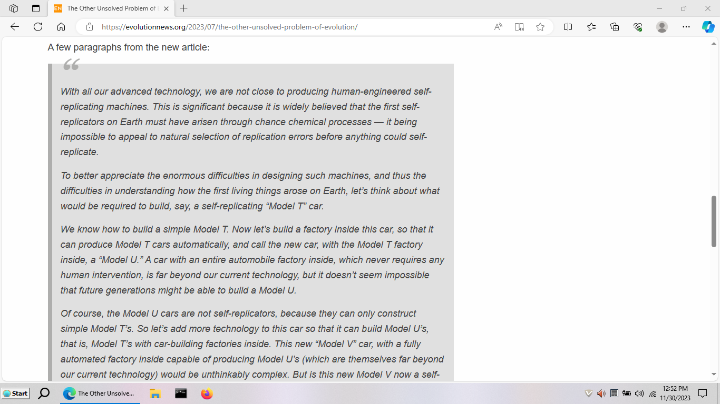

Slide 14
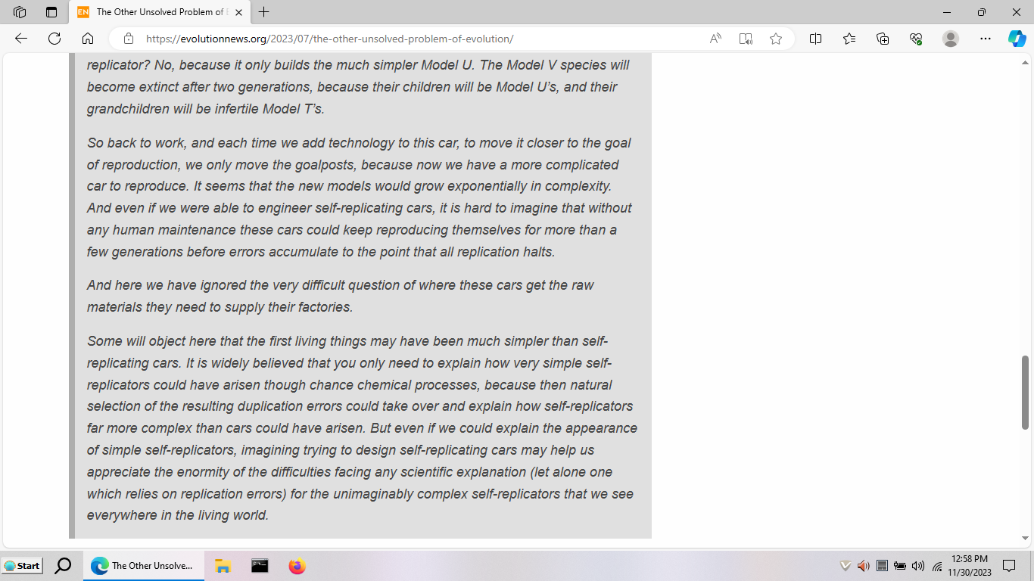

Slide 15
The evolution from the first life form to complex animals: Darwin’s implausible explanation for evolution becomes even more implausible with each new biological and biochemical discovery. It is still popular today only because of “Le Conte’s axiom” and the fact that evolution doesn’t look like the way we think a Creator should have designed things. But the fossil record does look a lot like the development of human technology, with obvious similarities between each new invention and previous designs, but with large gaps where major new features appear.
Why Evolution is Different, part II (14:05-end)
(English, Spanish, Polish and Dutch subtitles)

Slide 16
There are large gaps in the fossil record where major new features appear, for the same reasons that there are large gaps in the history of human technology where major new features appear: gradual development of the new organs and new systems of organs that gave rise to new orders, classes and phyla would require the development of new but not yet useful features. So, Darwinism could not explain the development of these new features even if they did appear gradually, and they don’t.
2022 article in The Guardian --- “This classic idea of gradual change, one happy accident at a time, has so far fallen flat.”

Slide 17
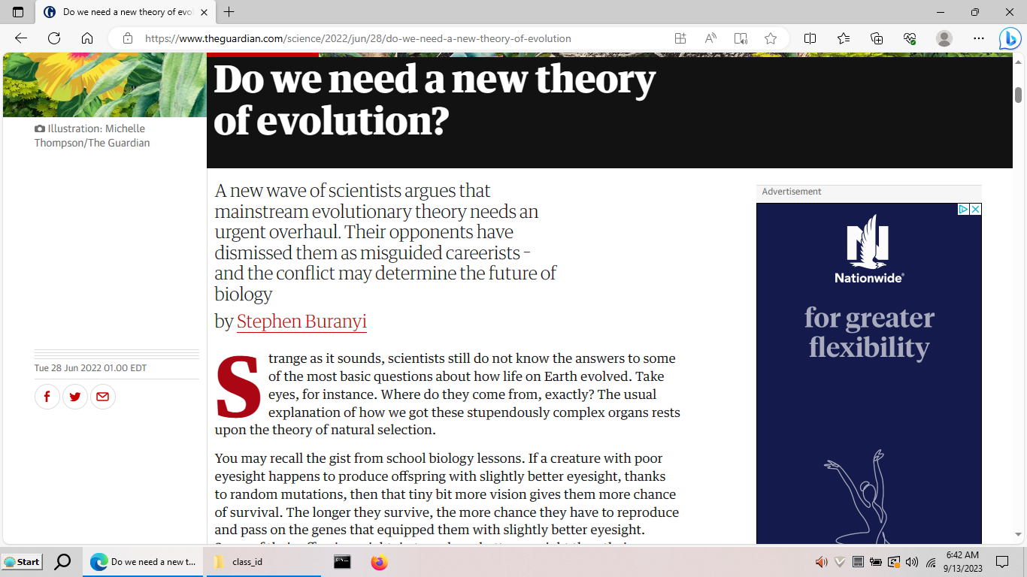

Slide 18
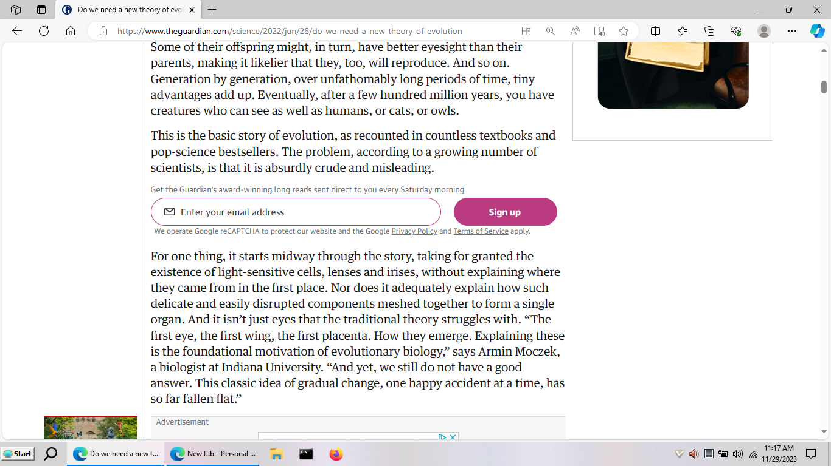

Slide 19
Carnivorous Plant Example
The aquatic bladderworts are delicate herbs that bear bladder-like traps 5mm or less in diameter. These traps have trigger hairs attached to a valve-like door which normally keeps the trap tightly closed. The sides of the trap are compressed under tension, but when a small form of animal life touches one of the trigger hairs the valve opens, the bladder suddenly expands, and the animal is sucked into the trap. The door closes at once, and in about 20 minutes the trap is set ready for another victim. ---Plants and Environment, 1947.

Slide 20
Irreducible complexity is ubiquitous in living things, the carnivorous plants are special only in that: “…it appears to be hard even to imagine clearcut selective advantages for all the thousands of postulated intermediate steps in a gradual scenario…for the origin of the complex carnivorous plant structures examined above.”—Lӧnnig and Becker

Slide 22
"[quoting Nachtwey 1959] 'Even a perfect suction trap displaying the astonishing ability to rapidly catch animals would have no advantage in the struggle for life because the prey would not be digested. Conversely, the production of highly effective digestive juices would be of no avail for the tip of a leaf as long as it could not capture the prey, which is absolutely necessary. But even if suction trap and digestive juices cooperated, nothing would be gained in the struggle for life. The dissolved proteins must also be absorbed and metabolized to species-specific proteins. The formation of the suction trap requires the perfect cooperation of many different genes and developmental factors. At the end a benefit is reached in the struggle for life, but not by any evolutionary stage.' Nachtwey concluded that none of the contemporary evolutionary theories was able to answer these questions, proposing that the answer might lie outside the present scientific paradigms."—Lӧnnig and Becker

Slide 23
The origin of intelligent, conscious humans: If you believe that humans are the result of a purely mechanical process such as natural selection of random mutations, you are forced to believe we are just machines. But I am not just a machine, so even if unintelligent forces could explain the appearance of complex animals, these forces cannot explain how I got inside one of these animals.
Video: A Summary ... (points 5-6)
(English, Spanish and Polish subtitles)

Slide 24
The universe had a beginning and since there were no natural causes before Nature came into existence, science cannot ever hope to explain this beginning. (Note: if it is hard to believe the universe had a beginning, it is equally hard to believe it did not. For example, if it were infinitely old, shouldn’t all stars have burned out long ago? How long ago---a trillion years ago? Why not long before that?)
The Big Bang (0-6:51)

Slide 25
Other links: Summer 2023 Class at Faith Lutheran Albuquerque In the Beginning and Other Essays on Intelligent Design https://math.utep.edu/Faculty/sewell/articles/summary.pptx

